Slide 1

STuFun
Web Application for Mini Project

Slide 2

Project Supervisor : Mr. Vaibhav Diwan
Team Members
Anubhav Nag
Jalanki Nayak
Kartik Agrawal
Tushar Gupta
Yash Vardhan

Slide 3
Project Index
Introduction
Motivation
Proposed Solution
Objective to Achieve
Technology Platforms Overview
Application Feature Overview
Application Snapshots
Strength of the System
Evaluation
Future Work

Slide 4
Introduction
In today’s world, there is hardly anyone who does not uses Chatting Application like WhatsApp, Hike etc. for connecting with their friends and family.
In these Applications we can do personal chats with a particular person or we can create chatting groups in which we can chat with more than one people at a time.
Now a days these groups are also used for educational purposes like teachers can create groups of their class and can share information into these groups like notes, videos related to topics, and many more things. But using these groups for educational purposes has some limitations.
.
There are various cases where such apps fails or don’t have a sense of formality

Slide 5
motivation
Consider a situation where teachers gives an assignment and provided a deadline of submission.
If students submit their assignment in the same group, then it will be quite difficult for teacher to manage the assignments.
To avoid it, teacher will either provide his/her email id for assignment submission or use another platforms like Google Classroom for work related to assignments.
Consider another situation where student is having some doubt regarding a topic and he/she want to discuss it with class.
Normally students share their doubts in the group and a discussion starts on that topic.
This type of discussion is considered as informal discussion and is not preferable in official groups
Consider a situation where teachers want to conduct a quiz among their students.
So, they must use another platform for organizing the quiz and maintaining the record of each quiz.
.

Slide 6
Proposed Solution
Groups in these Chatting Applications should be used for informal chats and fun. To overcome such limitations, a web application need to be made which contains the features of both chatting application and classroom. This application would incorporate the following features
A Chat portion whose functionality will be like WhatsApp Web chat. We can chat personally with anyone. We can also send photos, documents, links etc.. via chat.
A Classroom portion which will work on the functionality of Google Classroom. User can create a class and each class will be having a unique id. User can also join a class just by entering the class id.
➢ If you have created a class
1.) You can see the details of those members who have joined your class.
2.) You can upload assignments with deadlines and can monitor the list of students who have submitted it.
3.) You can add notifications bout academics with a set date and time
➢If you have joined a class, you will have the following privileges
1.) You can see the list of assignments along with their deadlines. One can submit the assignments by clicking on it.
2.) You can see the notifications added by the teacher.
Along with this, there will be a discussion panel which will be open for both teacher and students.
1.) Student can ask their queries and who so ever knows the answer can respond to that query.
2.) A list of query will be displayed in discussion panel from where student can view a query and it’s answer.

Slide 7
objective to achieve
The primary application objective of this Web application, StuFun is to serve both as a chatting app and as a classroom app that focuses on the student and teacher side of the problem. The project must have begun by January 2021 and should be completed by the end of April 2021 as fully functional.
The educational objective of the project is that by the end of the project all team members would have learned about the basics of the Web development.
As the Web App is a chat application it must have a functional chat infrastructure in two modes, viz a person-to-person mode and common group mode, the app should also be able to provide basic functionalities that everyday use apps like WhatsApp, Messenger, Hike provide.
On the part of the classroom, the objective is to create a classroom with a chat room/groups like infrastructure where students can interact with each other and their teachers on matters of their class and studies.

Slide 8
Technology platform overview
React (also known as React.js or ReactJS) is an open-source, front end, JavaScript library for building user interfaces or UI components. It is maintained by Facebook and a community of individual developers and companies. React can be used as a base in the development of single-page or mobile applications. React is only concerned with state management and rendering that state to the DOM
Express.js, or simply Express, is a back end web application framework for Node.js, released as free and open-source software under the MIT License. It is designed for building web applications and APIs. It has been called the de facto standard server framework for Node.js. Express is the back-end component of popular development stacks like the MEAN, MERN or MEVN stack.

Slide 9
Technology platform overview
Firebase Realtime Database - The Firebase Realtime Database is cloud-hosted. Data is stored as JSON and synchronized in real-time to every connected client. When you build cross-platform apps with our iOS, Android, and JavaScript SDKs, all of your clients share one Realtime Database instance and automatically receive updates with the newest data.
Node.js is an open-source, cross-platform, back-end JavaScript runtime environment that runs on the V8 engine and executes JavaScript code outside a web browser. Node.js lets developers use JavaScript to write command line tools and for server-side scripting—running scripts server-side to produce dynamic web page content before the page is sent to the user's web browser.

Slide 10
Application feature overview
The whole application consists of 2 actors i.e., Teacher and Student. Both these actors have some same and some different functionalities which differentiate the actors inside the application. These functionalities are :
FOR TEACHER
Registration/Login with email address by entering appropriate details.
Chat with other users
Create Classroom and students with sharing unique Class ID
Add announcements and conduct discussions in Classroom
Manage students as they can be blocked or removed.
Delete a classroom when its not needed, everything associated with the classroom would also delete permanently
Manage a profile by adding data about himself and his organizations and can also reset password
FOR STUDENT
Registration/Login using email address and adding appropriate details about them and their academics.
Chat with other users
Join Classroom with help of Class ID
View Announcements and ask queries to their teacher and fellow students.
View and chat with classmates directly, as all participants names will be visible to each other.
Manage a profile by adding data about himself and his organizations and can also reset password

Slide 11

Application snapshots

Slide 12
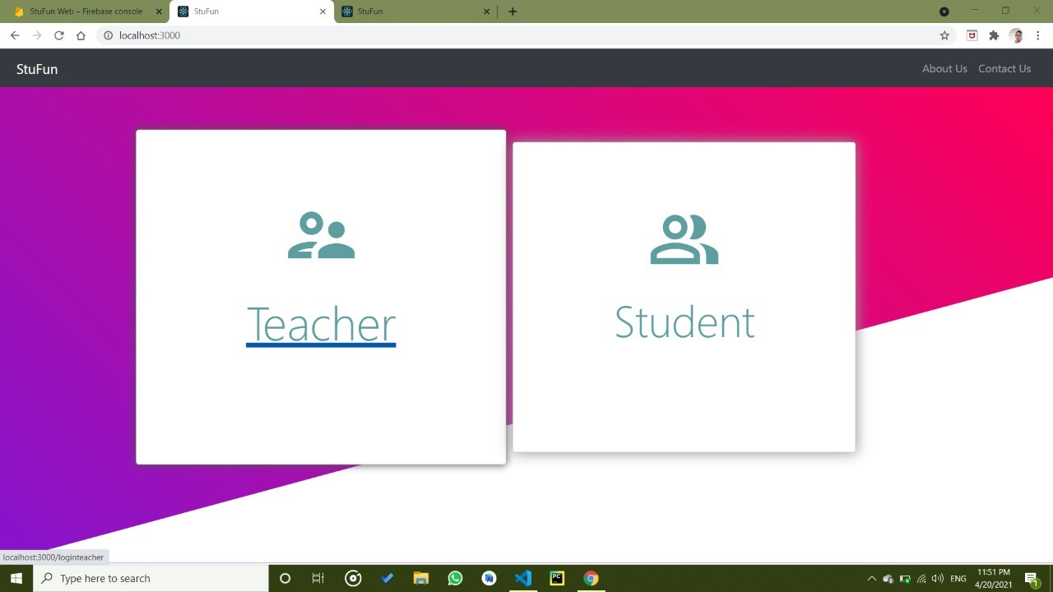
This is the Home Page of the website where the user will be asked to choose either Teacher for teacher account or Student for student account to proceed further.

Slide 13
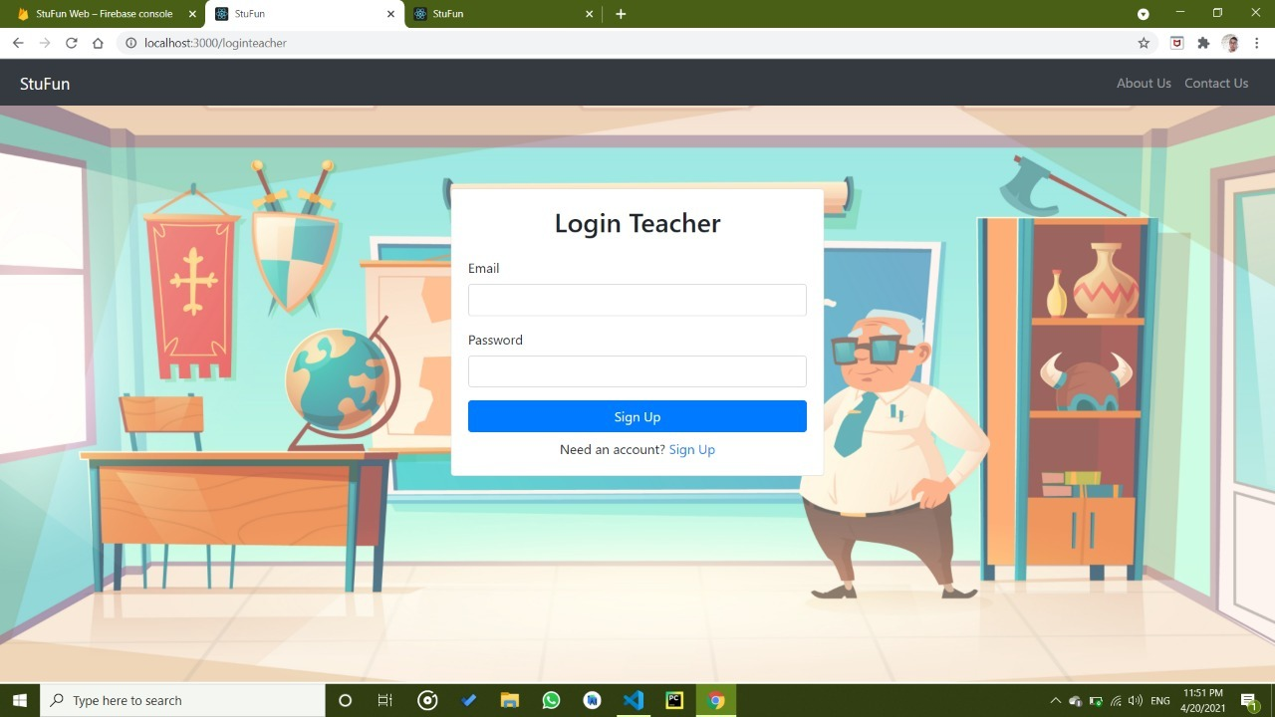
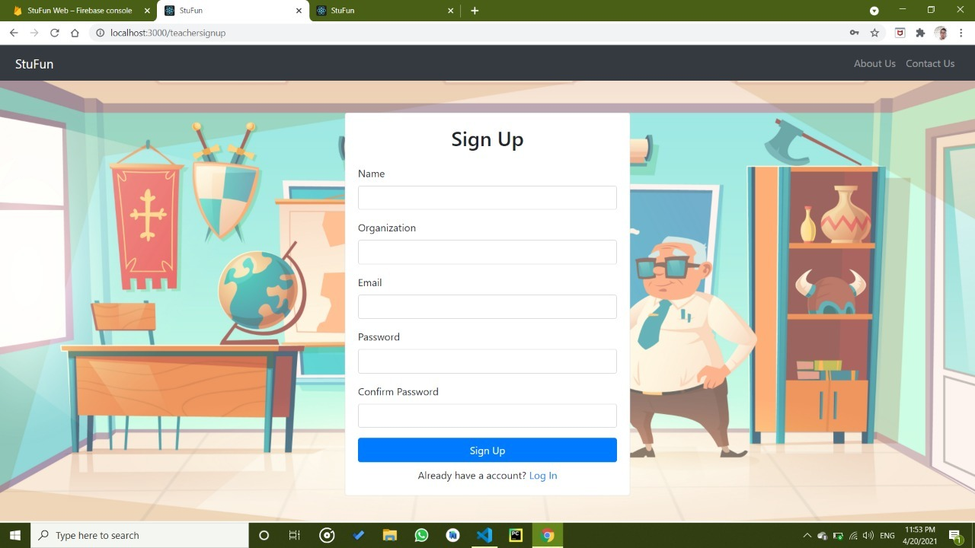
For sign up, we have use firebase authentication system. During signup user will ask for email id and password. After validation it will send a verification code to a user given id. After successful verification user refers to the profile creation activity. The teacher will be asked for an image, name, and Organization name. If any one of the details is not present then it will show an error.
Login activity will ask for email and password. if both the things are matched it get access to the user to the application otherwise it will show a valid error message.

Slide 14
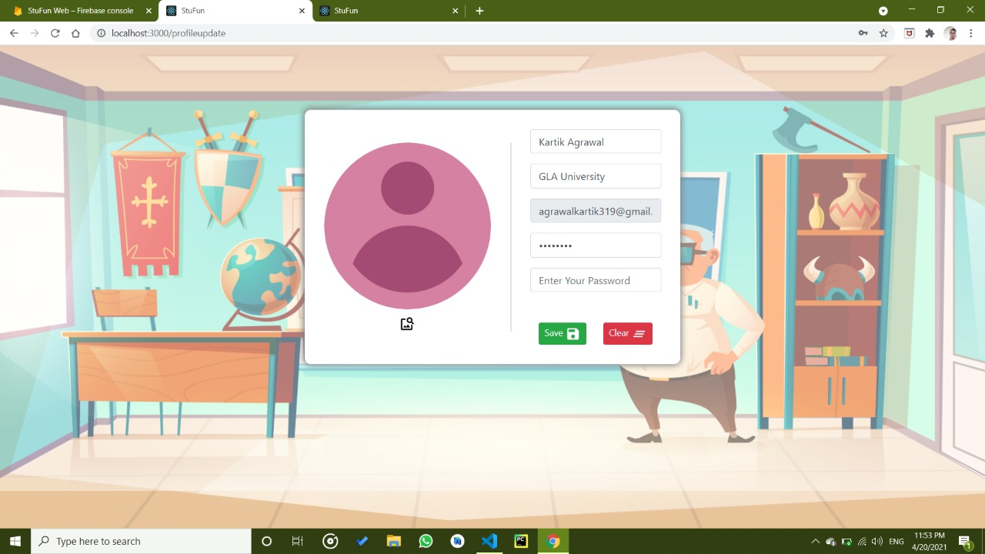
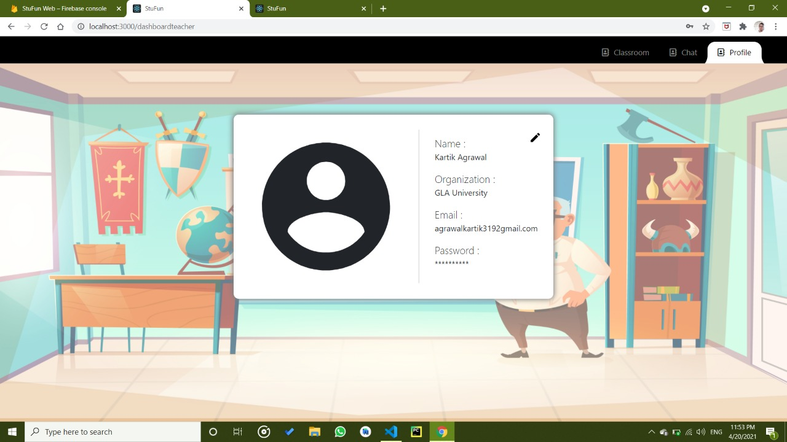
Setting Activity shows the profile detail and shows the option to change the profile details. Edit Profile Activity allow user to change details such as name and organization.

Slide 15
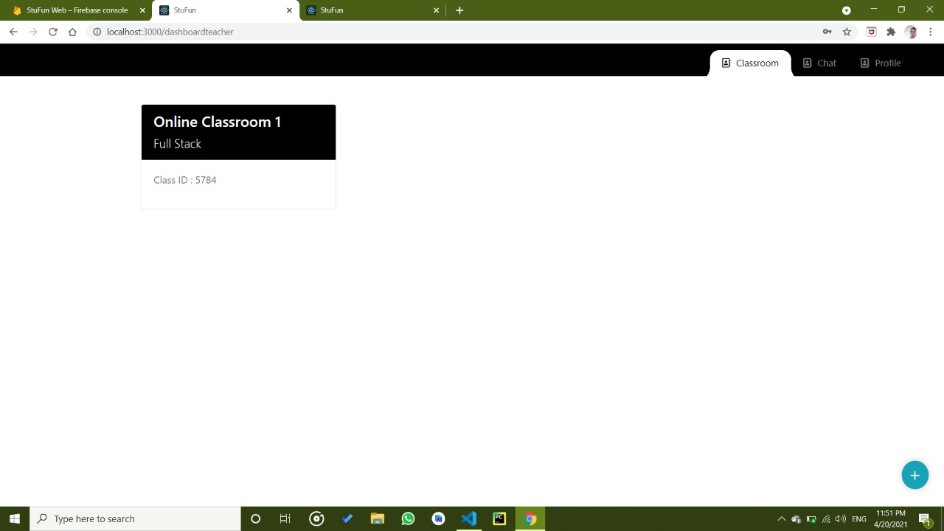
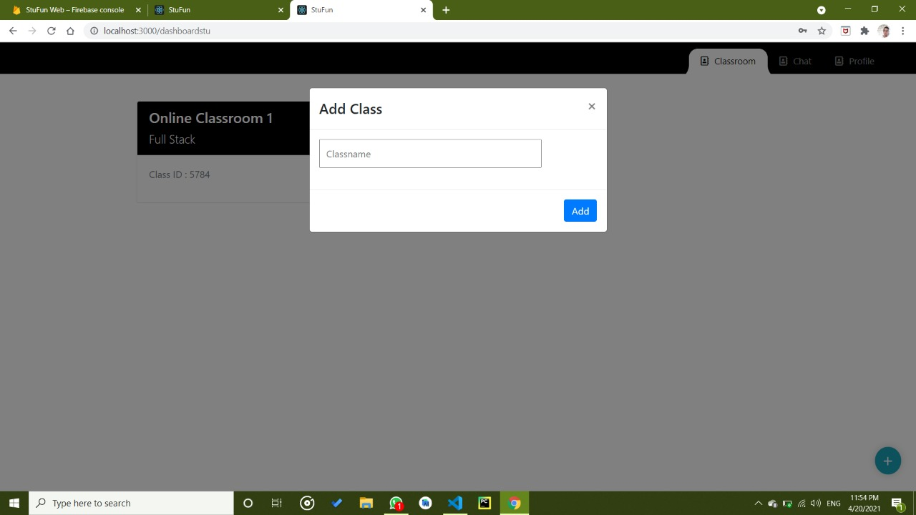
On the home page, the teacher can view a list of all the class that are created by him.
He can also create a new class by simply click the floating action button situated at the bottom-right corner.
We have termed this homepage as a dashboard simply because all the necessary operations can be reached from here.
Teacher has to fill some necessary details such as Class name and Class room Subject to create a class room. After validation, the teacher will receive a unique class code which is further used by the student to join the classroom. On the same activity, he has the option to send an invitation to join the class via email and SMS using external intent.

Slide 16
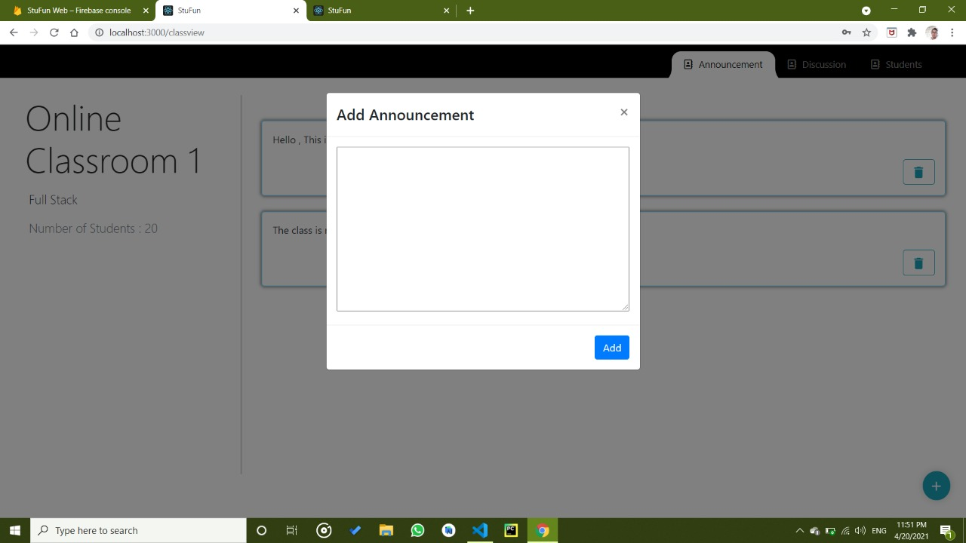
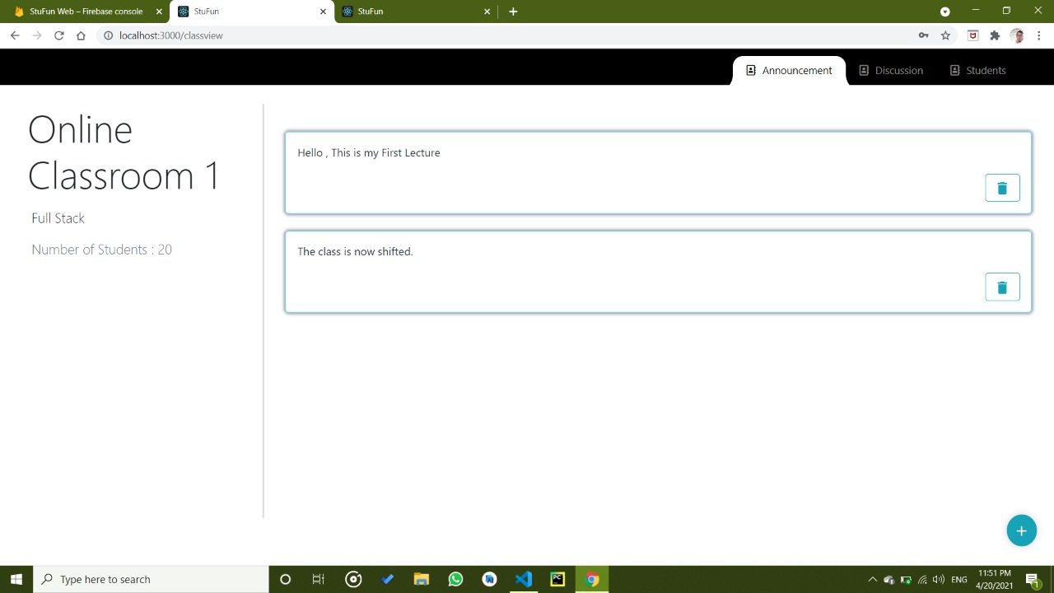
Teacher can easily add as many as announcement as he wants to add to a particular classroom.
After click add announcement the announcement gets added to the announcement recycler view of that particular classroom.
In this fragment, the teacher can view all the announcements which are made by him for the students. He can also delete an announcement by just simply right-swipe the particular announcement which is want to delete.

Slide 17
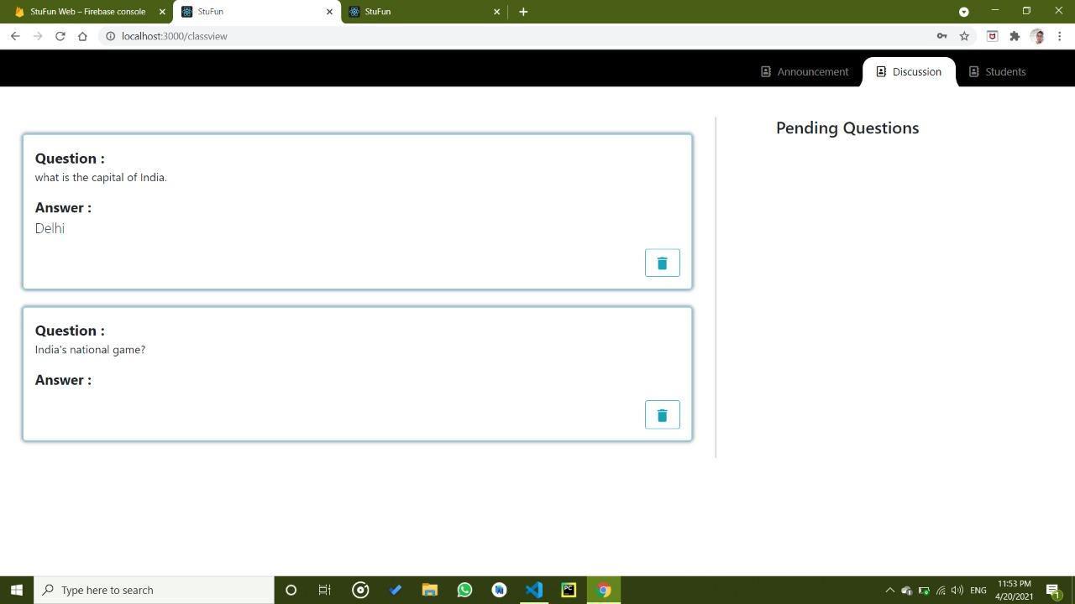
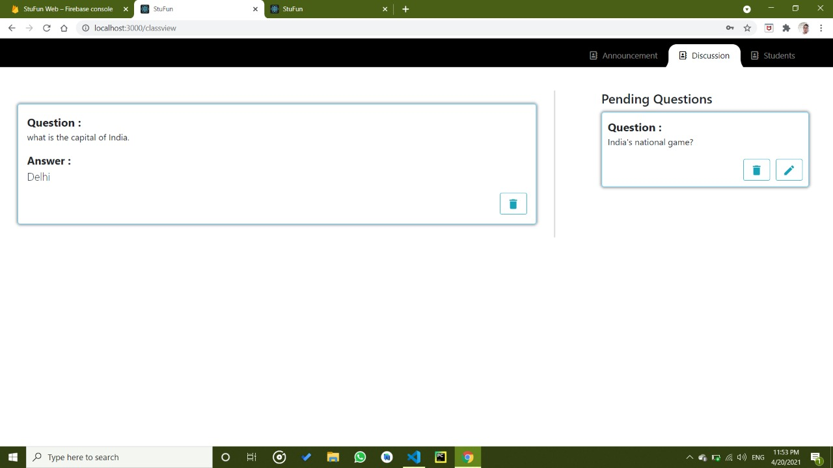
In the discussion fragment, the teacher can view all the previously asked queries with their answer as well as a pending query button.
Pending question activity contains a list of all the queries that are asked by the student and does not been answered by the teacher yet.
Here teacher has 2 options, either he can reply and post the query or he can delete the query.

Slide 18
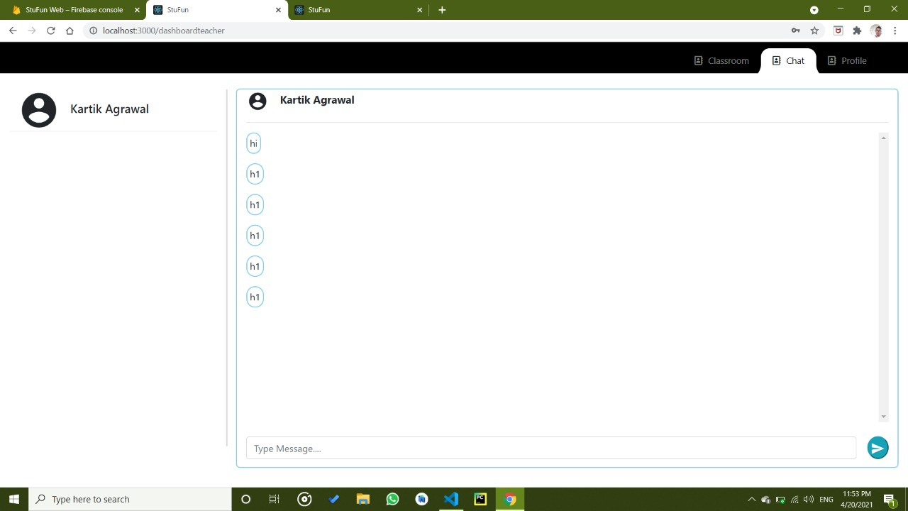
User can view a list of all the user with whom he has previously some chat.
Teacher can detail of all the student. Teacher can block the student from that particular class and also message him directly from here.
User can send a text or image message to another user.
At the bootom of the last message a “seen” mark indicates wheather a receiver has seen a message or not.
Top menu bar contains 2 option –
Profile – From where he can view the detail of receiver.
Clear chat – From where user can clear the chat.

Slide 19
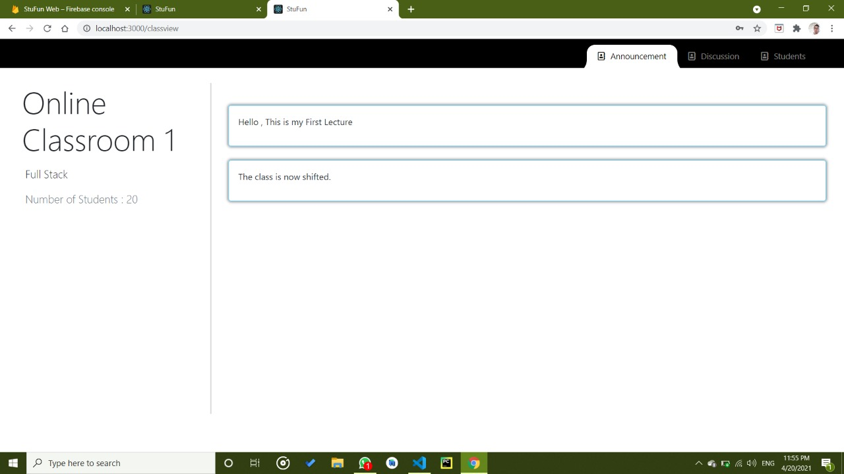
Student can join a classroom by entering a 4 digit unique code given to him by the teacher.
Student can view a list of all the announcements made by teacher which keeps him updated.

Slide 20
Strength of the system
The Web app provides an environment for study which makes the app more of a formal classroom and less of a casual chatting Website.
Many young students who use their parent's mobile numbers for joining their school group can now join classroom with their email-id.
The use of email as the primary key gives many advantages to the teacher as from now, he can send information and resources through email.
Another major strength of StuFun is, that it works fine with a slow internet connection.
The UI and design of the app has been constructed in such a way that is easy to use not only for the students and teachers but also for parents.

Slide 21
Evaluation
There are some limitations in the system, such as:
The web app provides for a system of creating classes, but classes are not connected in any way like in the real world where in an institution classes of similar structure are closely connected.
Facility of backing up data isn’t provided as it requires a large constant running database and administration round the clock.
As google firebase is the database of choice it only provides for a certain number of classes and student using the app at any time given.
Students only up to a certain limit can be added in a classroom thus for a bigger class separate classrooms has to be created.

Slide 22
Future work
As a team we aspire to make our app at least of market standards and help institutions, teachers and students getting a better online learning domain. This can be achieved by
Getting a better and industry par user interface to ease the use of our application.
Adding more functionalities in the classroom as to mimic a real-world class and creating a better overall experience.
Giving more options in the personal chat following the degree and grade of Chat app leaders as the likes of WhatsApp and Messenger.
Building a bigger and better database so more classes and students can be added and to provide a more reliable and consistent data-center.
Expanding our application to various mobile and web platforms such as iOS application so more and more new users can be connected, and old users can access their account across multiple platforms.

Slide 23
Thank you

